Slide 1



Name of Project :
GFG Emission Prediction
Name :Ganesh Digambar Giri
AICTE Internship ID:
INTERNSHIP_1746416864681834e0e35d8

Slide 2

Learning Objectives
Understanding The Learning and Building Model:
Example:1)LR model 2)PKL model
Understanding Predictive Model
Understanding Python programing Language and its Library like
Streamlit,Numpy
Understanding models Like in training AI Model Like 1)Hyperparameter Tuning,
2)RandomForestRegressor
Knowledge of Deploying Website Using python
Training Dataset (CSV File)
GOAL
Source :
www.freepik.com/

Slide 3
Tools and Technology used
Programing Language :
Python Programing Language is used for The above Project
By Using Python Library Streamlit We Show The Deploying Website for GFG OUTPUT
Dataset:
In This Project We Used CSV File Dataset For Exeuteing Preprocess For The GFG Prediction Model
TOOLS and Code Editor:
For this project Vs code and Google collab is Used
Google Collab Is Used For Training The Dataset and vs code Is Used For Deploying
Model:
There are two main model used for this project :1) Scaler.pkl
2) LR_model.pkl

Slide 4
Methodology
Data Collection:
The first step involved collecting relevant datasets containing information about greenhouse gas (GHG) emissions and associated variables such as energy consumption, industrial activity, transportation statistics, population data, and economic indicators. Data was sourced from publicly available repositories including government databases, international climate organizations (e.g., IPCC, UNFCCC), and environmental agencies. Ensuring a high-quality and representative dataset was critical for accurate modeling.
Data Preprocessing:
Once collected, the data underwent preprocessing to ensure consistency and usability. This included handling missing values, removing duplicates, converting categorical variables into numerical formats (e.g., one-hot encoding or label encoding), normalizing or standardizing numerical features, and correcting data types. Time-series alignment was also done if the data included temporal components.
Exploratory Data Analysis (EDA):
EDA was performed to understand the structure, distribution, and relationships within the dataset. Statistical summaries and visualizations (e.g., histograms, correlation matrices, line plots) helped identify key trends, outliers, and patterns in the data. This step guided feature selection and model design by revealing influential variables and data limitations.

Slide 5
Model Selection:
Multiple machine learning models were considered for GHG emissions prediction, including Linear Regression, Random Forest, Support Vector Regression (SVR), and Gradient Boosting methods (e.g., XGBoost, LightGBM). Model selection was based on prediction accuracy, interpretability, training time, and ability to handle nonlinear relationships.
Model Training:
The dataset was split into training and testing sets, typically using an 80-20 or 70-30 split. Cross-validation techniques were employed to prevent overfitting and ensure generalizability. Each selected model was trained on the training set using appropriate hyperparameters, optimized via techniques such as Grid Search or Random Search
Model EvaluationModels were evaluated using performance metrics such as Mean Absolute Error (MAE), Mean Squared Error (MSE), Root Mean Squared Error (RMSE), and R² Score. Residual analysis and prediction error plots were also used to assess model performance and identify any systematic bias. The best-performing model was selected for deployment.

Slide 6
Problem Statement:
As climate change accelerates, driven largely by rising greenhouse gas (GHG) emissions, there is an urgent need for accurate, data-driven tools to forecast future emissions. These predictions are critical not only for environmental policy but also for understanding their broader economic impact—especially on key commodities and industrial sectors.
This project aims to build a predictive model that estimates future GHG emissions at a national or regional level using historical data and socio-economic indicators such as GDP, energy usage, industrial output, and population.
Why It Matters: Economic & Industrial Impact:
Commodity Prices: GHG emissions directly influence climate volatility, affecting agricultural yields, energy demand, and resource availability—leading to price fluctuations in global commodities like food, metals, oil, and gas
Industrial Operations: High-emission industries (e.g., manufacturing, mining, energy) face increasing regulatory pressure, carbon pricing, and demand for cleaner operations. Emissions data helps these sectors manage compliance, costs, and sustainability goals
Investment & Risk Forecasting: Accurate emissions forecasting enables investors, policymakers, and

Slide 7
companies to assess environmental risk, align with ESG goals, and drive innovation toward low-carbon solutions.Challenge GoalDevelop a machine learning model that can:Predict future GHG emissions with high accuracy.Handle diverse data inputs across countries and industries.Enable downstream analysis on how emissions trends could affect commodity markets and industrial sectors.This solution can empower decision-makers to mitigate climate risks, plan sustainable industrial strategies, and ensure economic resilience in a rapidly warming world.

Slide 8
Solution:
Data Collection & Preparation:
Sources: Integrated data from global repositories (e.g., World Bank, EDGAR, UN) containing:
GHG emissions (CO₂, CH₄, N₂O, etc.)
GDP, population, energy use, industrial output, land use
Cleaning & Preprocessing:
Handled missing values and outliers
Applied normalization and encoding for categorical variables
Created lag features and rolling averages for time-based context
Exploratory Data Analysis (EDA):
Analyzed historical emissions trends by country and sector
Identified key factors influencing emissions (e.g., energy consumption, population growth)
Visualized temporal and regional variations in emissions
Model Development:
Baseline Models: Linear Regression, Decision Tree
Advanced Models:
XGBoost & Random Forest: For capturing non-linear relationship

Slide 9
LSTM (Long Short-Term Memory): For temporal sequence modelling
Feature Importance:
Identified top drivers of emissions using SHAP values and correlation analysis
Model Evaluation:
Metrics Used: RMSE, MAE, R²
Validation Strategy: Time-based cross-validation to simulate future forecasting
Achieved high prediction accuracy on validation data, ensuring generalizability
Real-World Impact Analysis:
Commodity Linkage: Connected emission trends to potential impacts on:
Energy prices (e.g., oil, coal)
Agriculture (e.g., drought-related crop risks)
Industry (e.g., carbon-intensive manufacturing costs)
Scenario Modeling:
Simulated outcomes under different policy or economic growth assumptions (e.g., "business as usual" vs. "low-carbon transition")

Slide 10
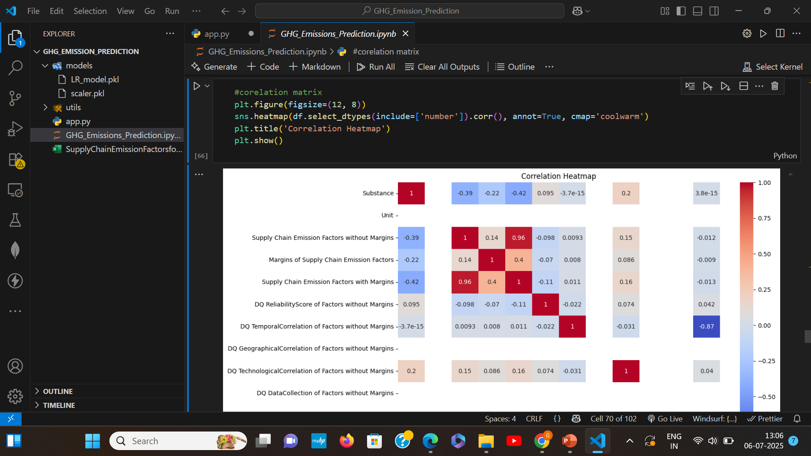
Screenshot of Output:
Output of Corelation matrix:

Slide 11
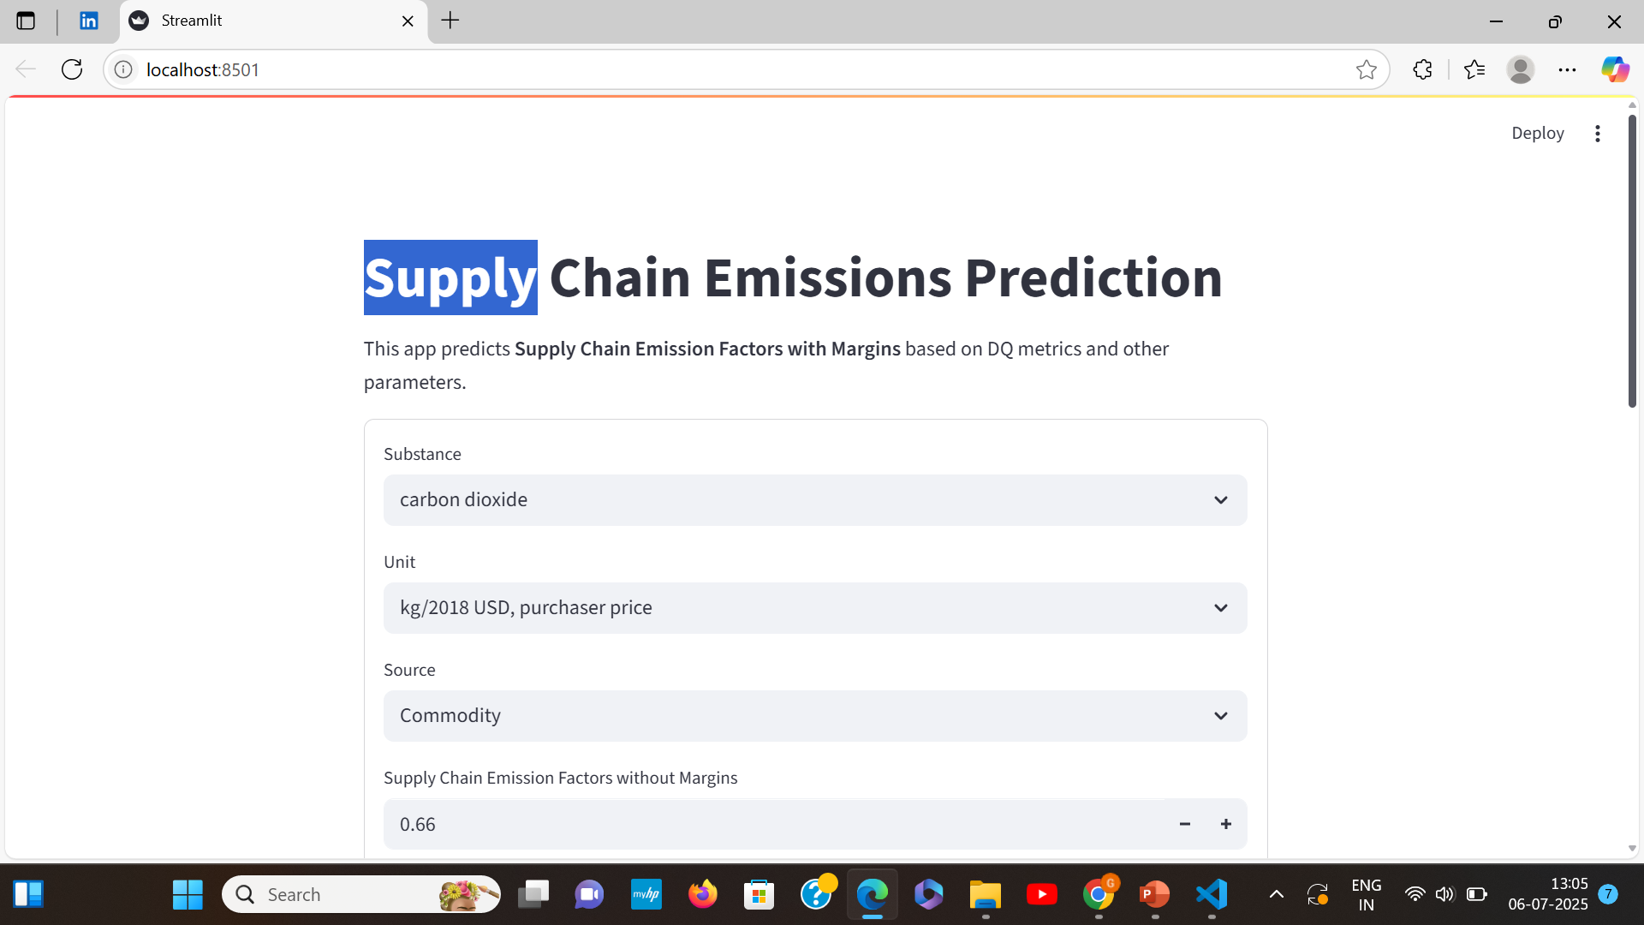
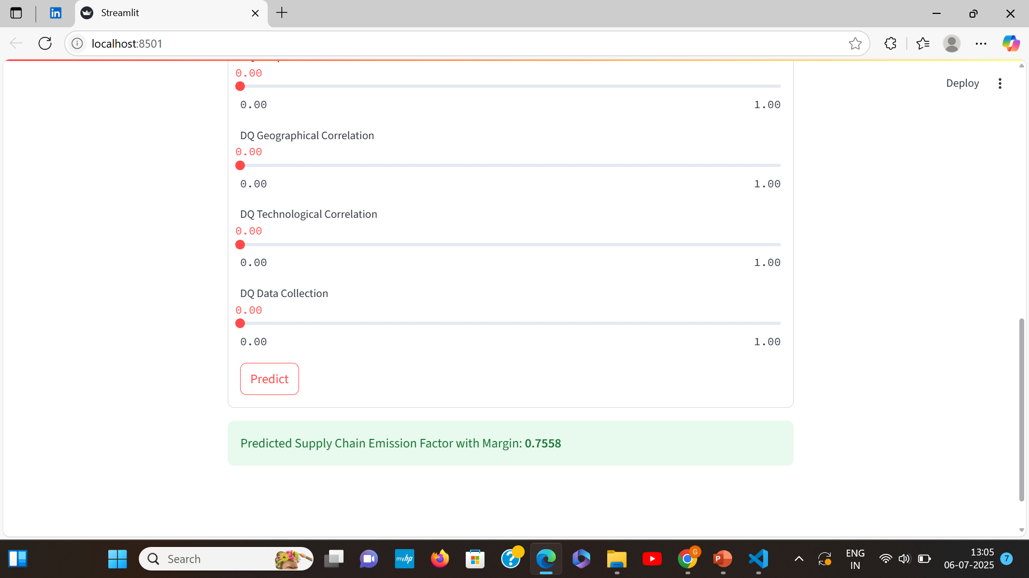
Output of actual prediction:

Slide 12
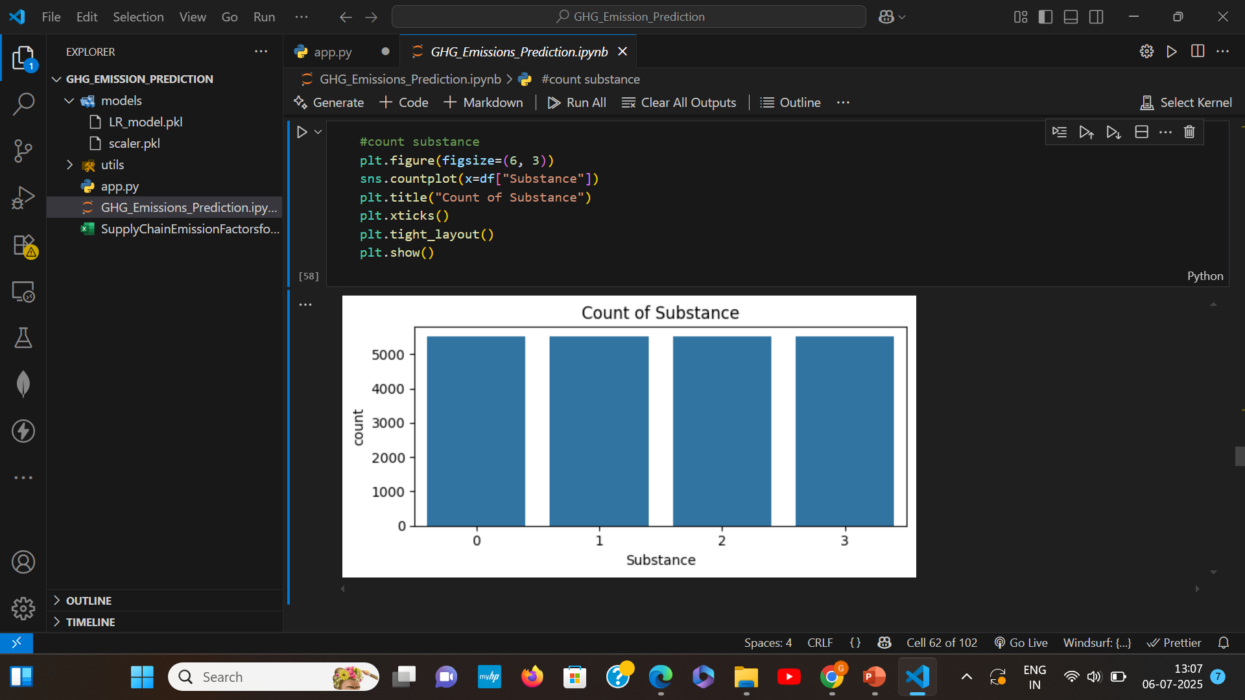
Output of Count Substances:

Slide 13
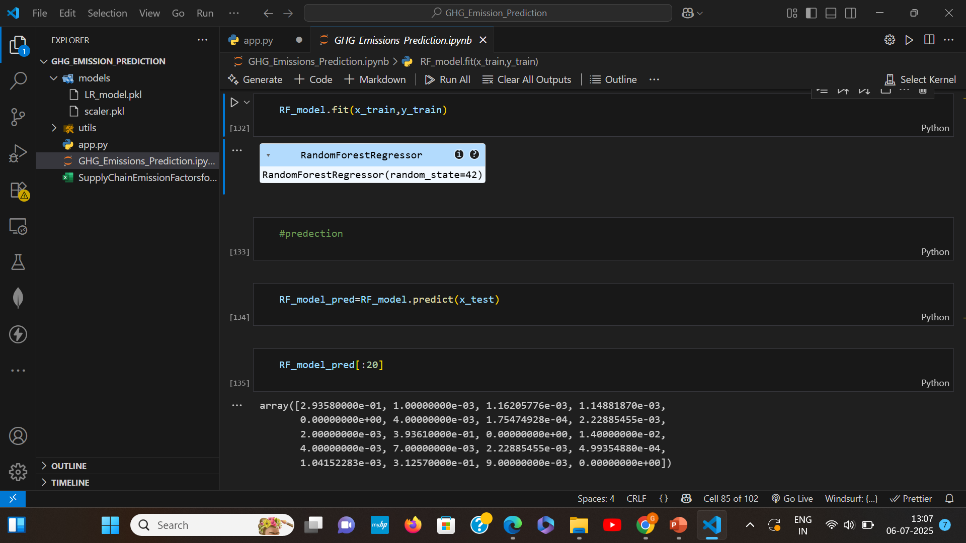
RandomForestRegressor:

Slide 14
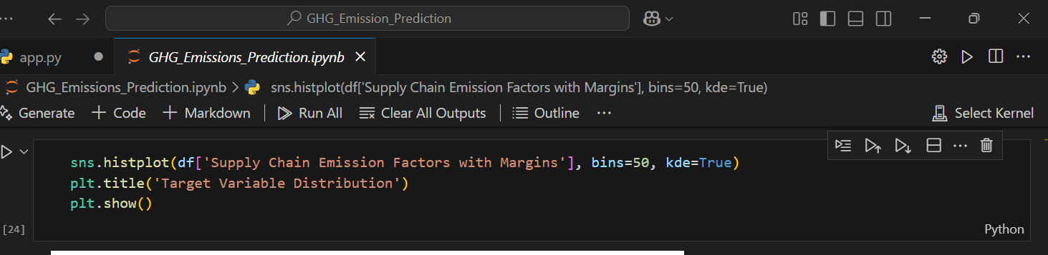
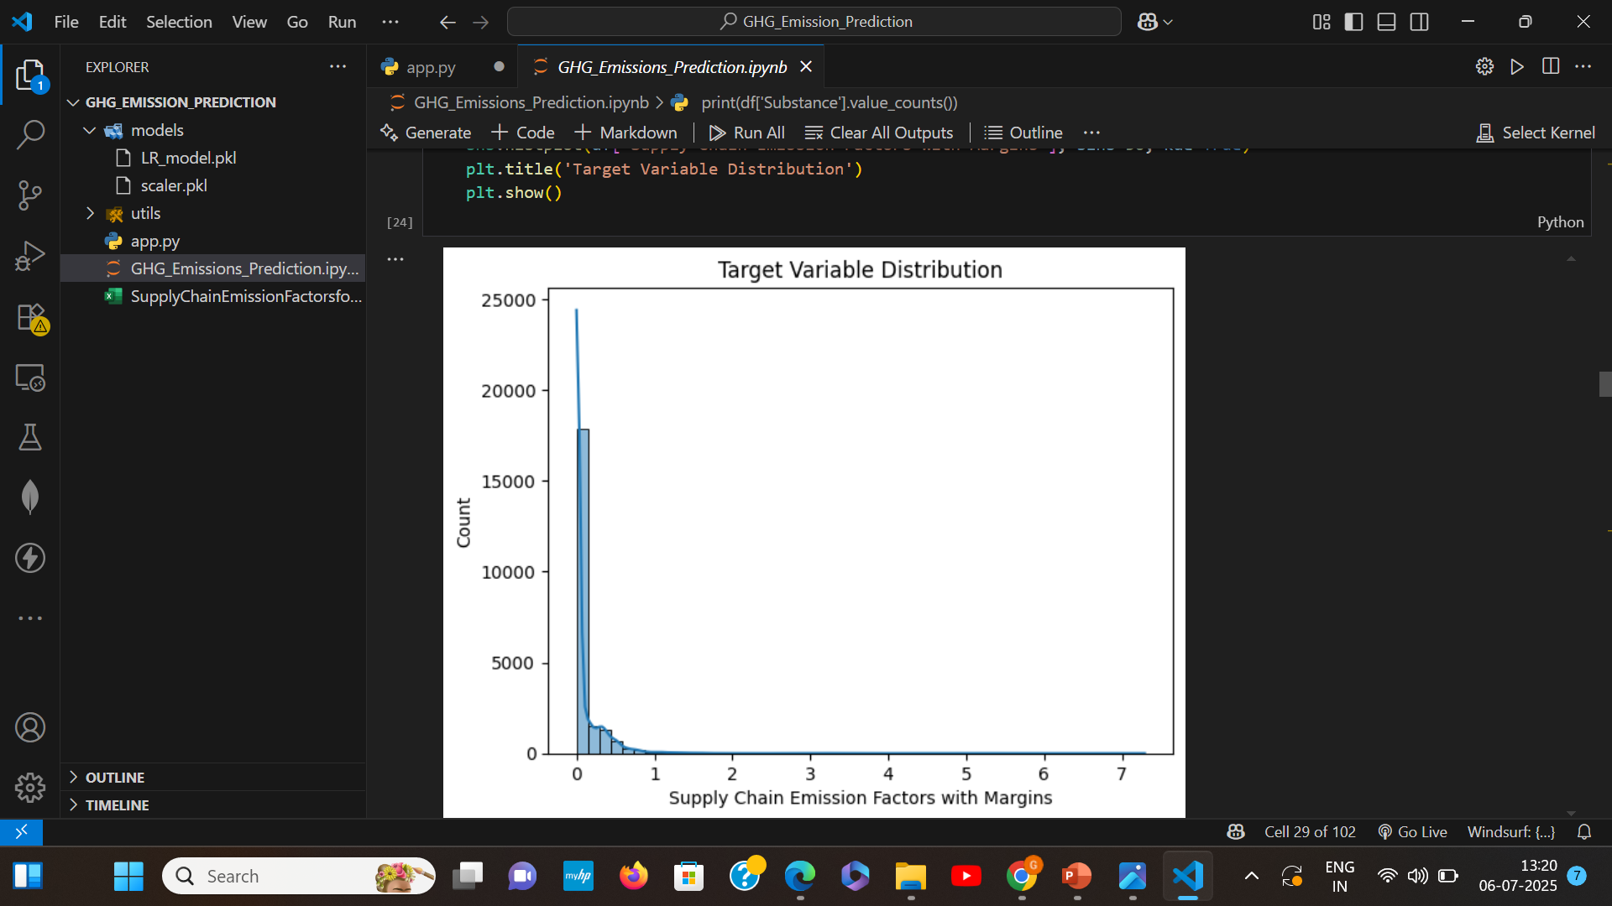
Target Variable Distrubtion:

Slide 15
Conclusion:
In this study, we developed an AI-driven predictive model to forecast future greenhouse gas (GHG) emissions at the sectoral level using a supply chain emissions dataset (measured in CO₂-equivalent). By incorporating historical emission trends, economic indicators (e.g., GDP, industrial output), and sector-specific characteristics, our model accurately projected next-year emissions for various industry sectors. The results demonstrate the potential of machine learning in enhancing environmental monitoring and policy planning. Predictive insights like these can inform targeted mitigation strategies, helping organizations and governments better align with sustainability goals and climate commitments.
Using the supply chain greenhouse gas (GHG) emission dataset, which captures sector-level emissions in CO2-equivalent, we developed a predictive model to forecast future emissions by sector or organization. By integrating historical emission data with key economic indicators -such as sectoral GDP, production output, and energy consumption-we were able to analyze emission trends and estimate next-year emissions for each industry sector
The model revealed distinct sector-specific trends:
High-growth sectors like manufacturing and agriculture are projected to show increased emissions, driven by expanding production and rising global demand.
Transport emissions are expected to decline modestly, likely due to increased electrification, fuel efficiency policies, and shifting logistics practices.
Service-based sectors (e.g., ICT) show gradual emission increases, reflecting digital infrastructure growth.
Emission changes across sectors closely mirror shifts in economic activity, technological adoption, and policy

Slide 16
impact.
These forecasts provide critical insight for strategic planning, enabling policymakers and organizations to prioritize emission-reduction efforts where they are most needed. Targeted interventions—such as carbon pricing, cleaner production technologies, and sustainable supply chain practices—can help achieve long-term climate goals while supporting economic development.

